Slide 1



HealthGuard AI
AI-Powered Early Diabetes Risk Prediction & Personalized Preventive Health Recommendation System
Presented By Ali Rilwan Bako
Programme 3MTT Mentorship
Mentor Mr. Isreal Odeajo

Slide 2











Problem Statement & Objectives
Delayed Detection Risk
Diabetes is a major global health challenge. Millions remain undiagnosed until severe secondary complications arise.
Barriers to Screening
Traditional screening requires clinical visits, lab blood work, and health professionals, limiting routine early access.
Escalating Healthcare Costs
High diagnostic expenses and lack of automated self-assessment tools prevent scalable proactive intervention.
PROJECT OBJECTIVE
Develop an AI-powered web app predicting diabetes risk from health metrics and auto-generating tailored preventive advice.

Slide 3










Solution & Architecture Overview
Frontend Layer
API & Services Layer
ML & Inference Engine
Interactive multi-step health assessment form
High-performance FastAPI REST endpoint
Optimized LightGBM binary classifier
Real-time form validation via React Hook Form
Strict Pydantic payload type checking
Instant probability scoring & risk level output
Responsive UI with dynamic risk visualization
CORS enabled for secure web API calls
Rule-based health recommendation generator

Slide 4












Technology Stack
Languages
Frontend
Backend API
Machine Learning
Dev Tools
API Standards
Primary Dataset
253,680
21
CDC Behavioral Risk Factor Surveillance System (BRFSS 2015) Diabetes Health Indicators
Survey Records
Health Indicators

Slide 5

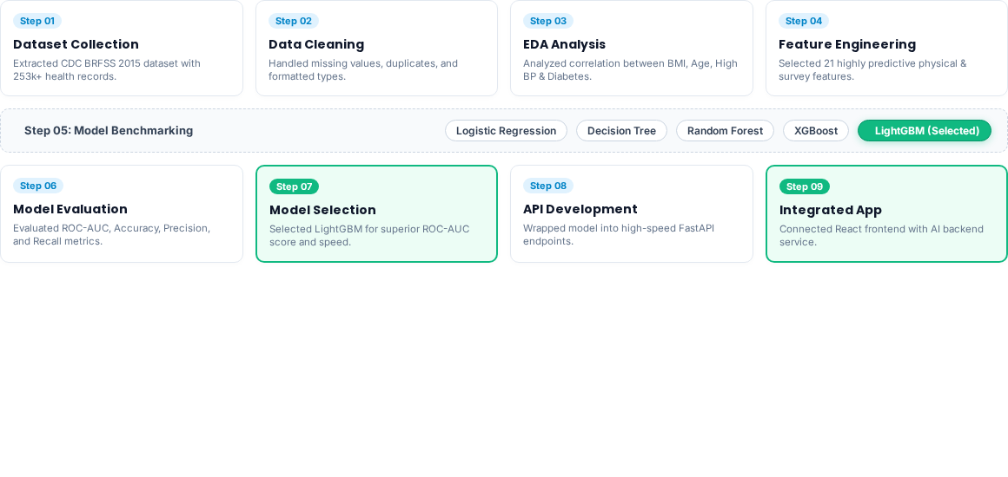
Project Methodology

Slide 6


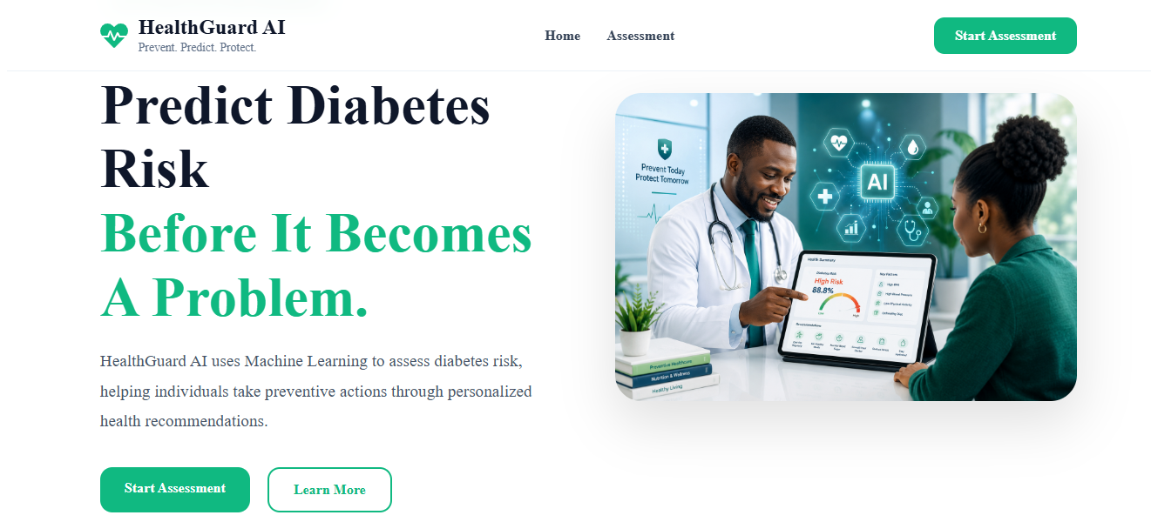
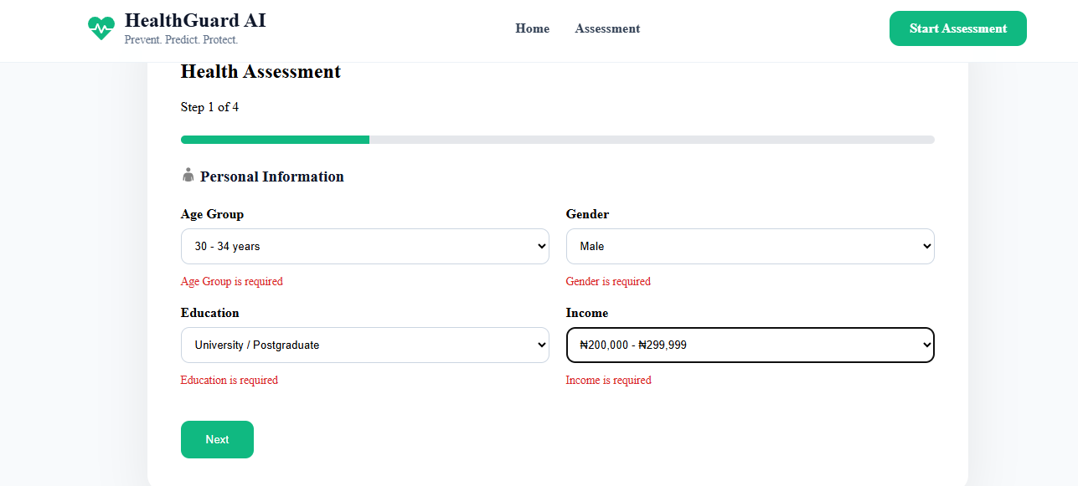

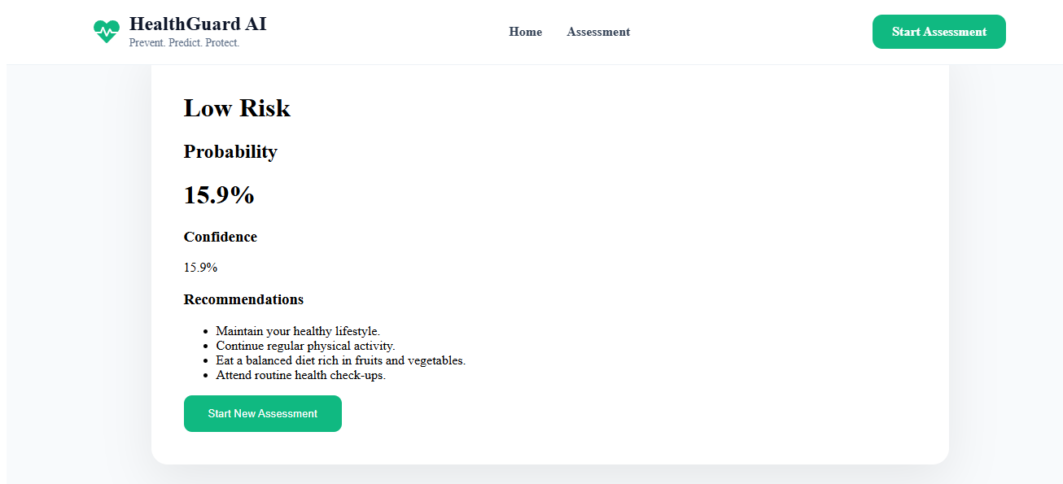
Results & Demonstration
Application Interface
Model Evaluation Benchmarking
Model | Accuracy | ROC-AUC
LightGBM Best | 75.22% | 83.05%
XGBoost | 75.03% | 82.85%
Logistic Regression | 74.58% | 82.32%
Random Forest | 73.58% | 81.20%
Decision Tree | 65.13% | 65.15%
Best Performing Classifier: LightGBM
Achieved top ROC-AUC (83.05%) with lightweight memory footprint.

Slide 7





Conclusion & Future Scope
Key Achievements
Challenges Overcome
Future Enhancements
•
Built end-to-end AI diabetes risk app
•
Addressing class imbalance in dataset
•
Integrate Explainable AI (SHAP / LIME)
•
Trained & evaluated 5 ML algorithms
•
Optimizing model hyperparameters
•
Expand to multi-disease prediction
•
Selected LightGBM as optimal model
•
Managing REST API integrations
•
Develop iOS / Android mobile application
•
Engineered FastAPI REST service
•
Handling CORS security policies
•
Electronic Health Record (EHR) integration
•
Integrated React UI with AI backend
•
Seamless frontend-backend state communication
•
Cloud deployment (AWS / Azure)
•
Generated tailored health advice
Thank You!
Questions & Discussions Welcome

